Slide 1
Physical mathematics 1.1 Statements
Assumptions of Physics collaboration

Slide 2
Outline
To develop a mathematical framework to keep track of the logical relationships between the statements that originate from the semantics of the statement

Slide 3

Universal $→$ same for everybody
First, let’s address these
Non-contradictory $→$ either something is true or false
Evidence based $→$ truth is determined experimentally
Statements: assertions that are universal and non-contradictory
Notes:
Examples -> Conclusion -> Some assertion are not universal
(Quine’s paradox – Yablo’s paradox) -> Logical consistency is not a property of individual statements -> Introduce the idea of logical contexts.

Slide 4
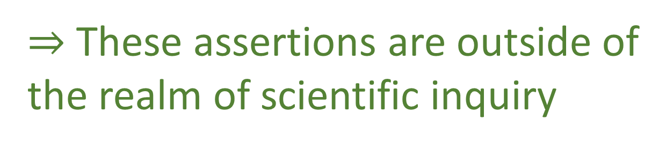
Not all assertions are universal
Jazz is marvelous
Different people may have different opinions
Green and red go well together
Is it morally justified to kill one person to save five
$⇒$ These assertions are outside of the realm of scientific inquiry

Slide 5
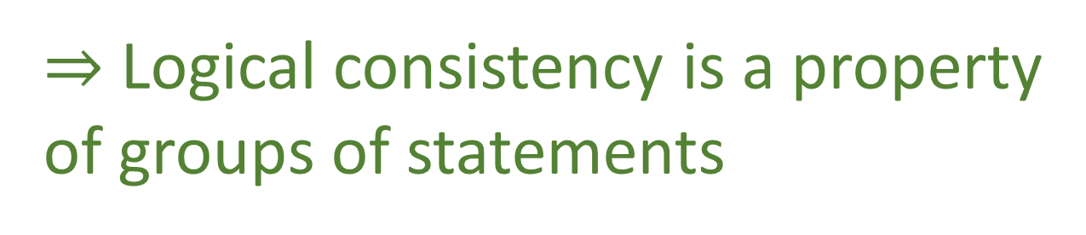
Liar paradox
Quine’s paradox
Yablo’s paradox
$⇒$ Logical consistency is a property
of groups of statements

Slide 6
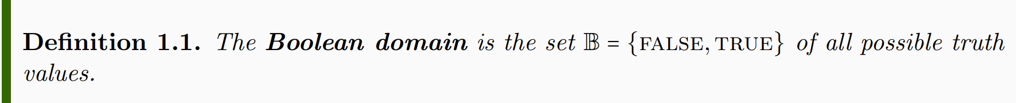
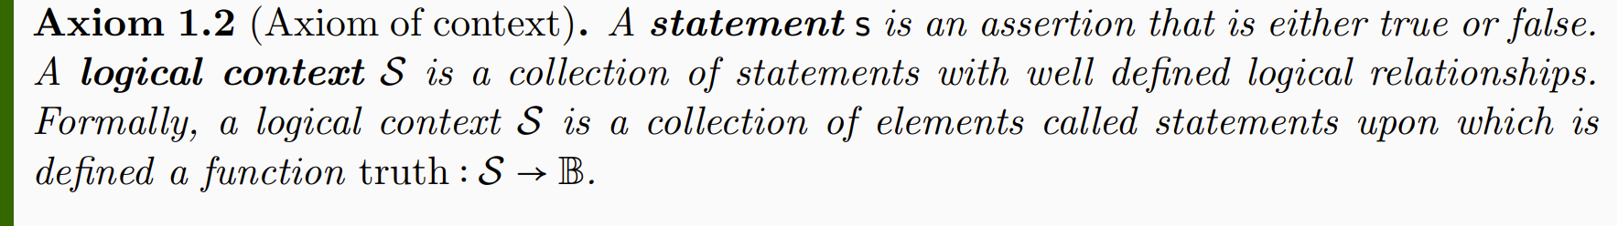
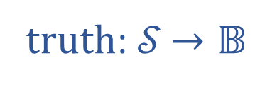

Informal part
Formal part
truth: 𝒮 $→𝔹$
𝒮
$$𝔹$$

Slide 7
TODO: grammar rules, language, etc…
Notes:
The statements are “prime elements”, no specified further (in terms of grammar, etc…), structure and meaning of the assertion is not part of the formal system (because it would be impossible… web of meaning)

Slide 8
Notes:
We capture logical relationships between statements by keeping track of what truth combinations are allowed by the semantic content of the statement (again, note that it’s a feature of the context, not of the individual statement)

Slide 9
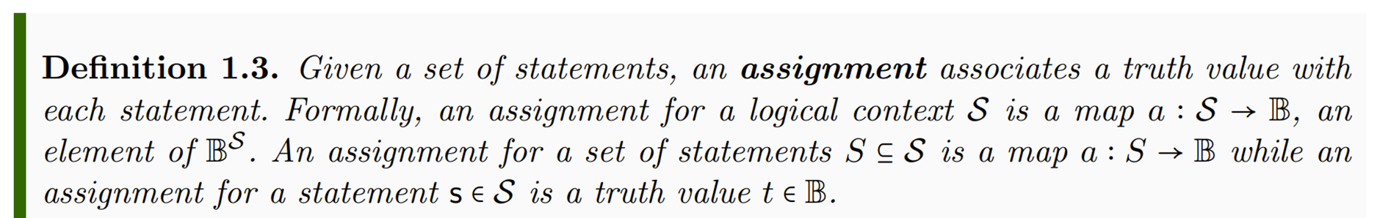

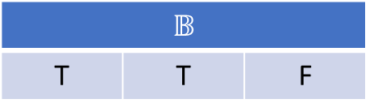
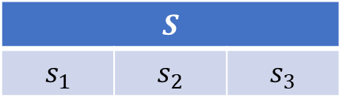
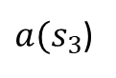
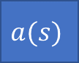
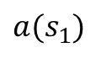
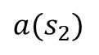
TODO: make horizontal
$$S$$
$$s_{1}$$ | $$s_{2}$$ | $$s_{3}$$
$$a(s)$$
$$𝔹$$
T | T | F
$$a(s_{1})$$
$$a(s_{2})$$
$a(s_{3}$)
Notes:
Part of the semantic content of the statements is captured by what truth value can be assigned

Slide 10
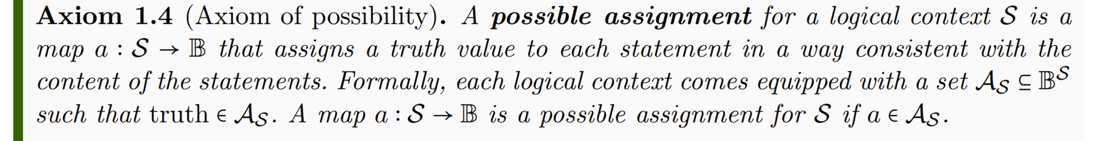
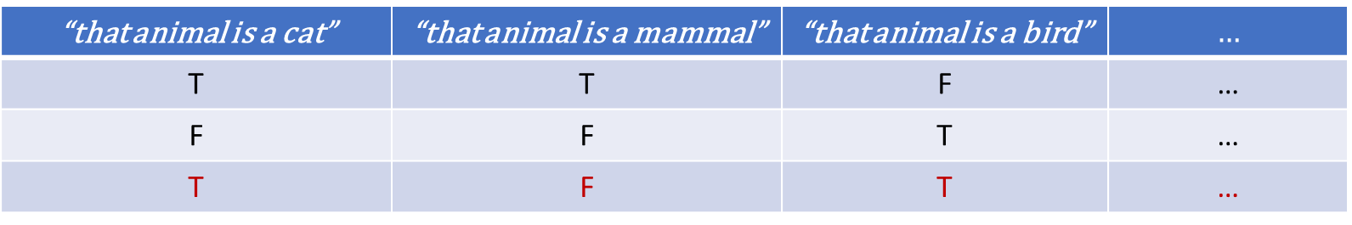
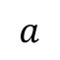
TODO: columns with text, add an “impossible assignment”
“that animal is a cat” | “that animal is a mammal” | “that animal is a bird” | $$…$$
T | T | F | …
F | F | T | …
T | F | T | …
$$a$$
Notes:
Possible assignments are determined by the semantic content of the statements

Slide 11
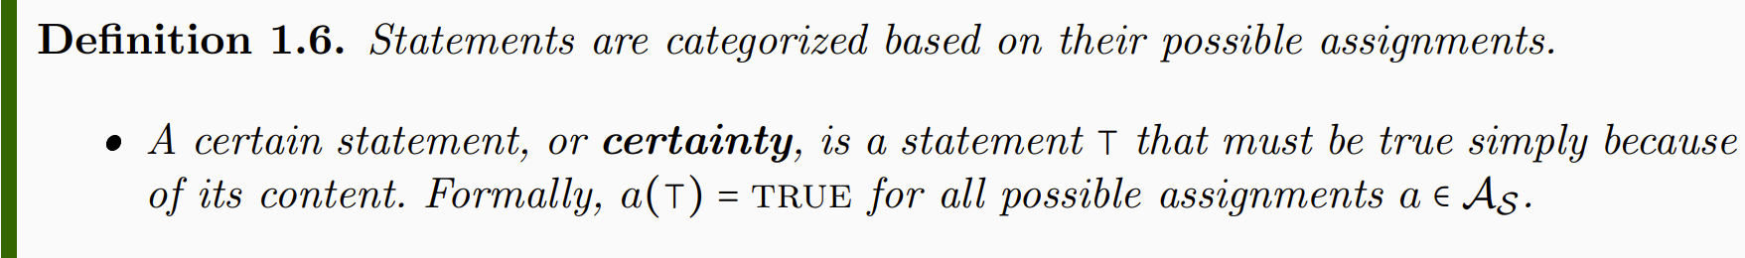
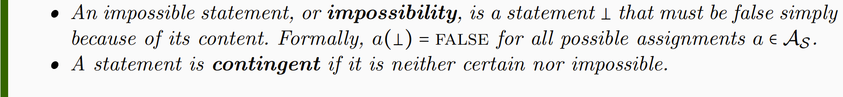
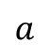
TODO: Table
“that cat is a mammal” | “that mammal is a cat” | “that mammal is a bird”
T | T | F
T | F | F
T | F | F
T | T | F
… | … | …
$$a$$
Notes:
NOTE: whether a statement is a certainty or not depends on context. Mass of the electron: contingent if measuring the mass, certainty for particle identification

Slide 12
Notes:
Want to keep track whether the truth of one statement depends on the truth of others: function on truth values – introduce truth tables

Slide 13
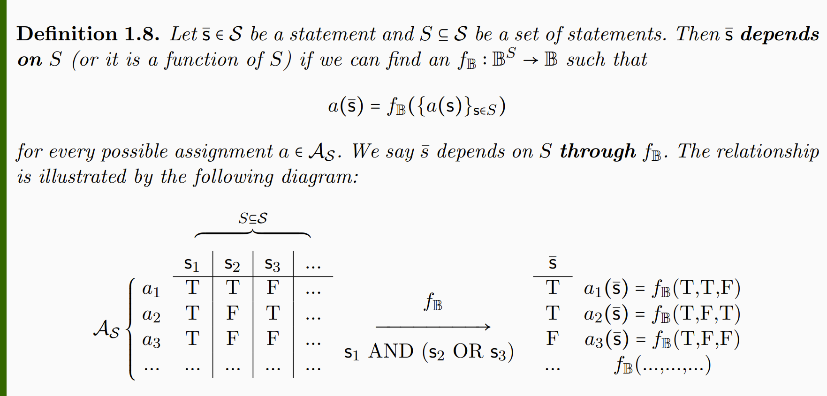

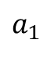
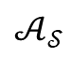
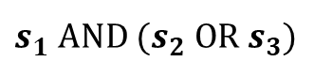
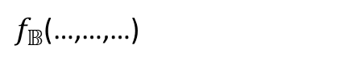
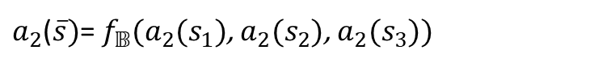
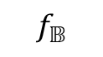

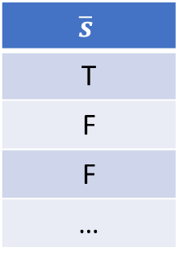
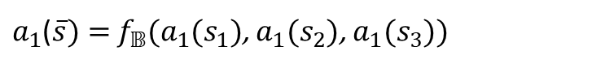
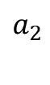
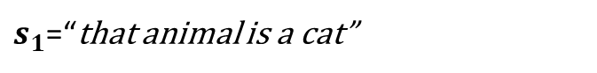
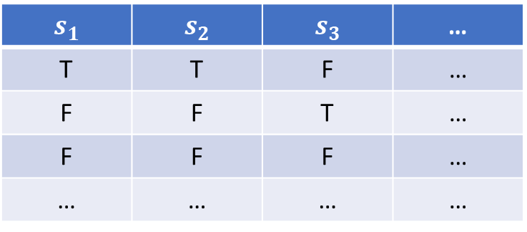
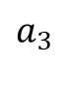
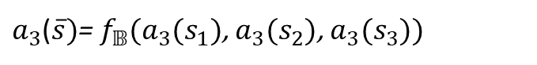
$$S$$
$$s_{1}$$ | $$s_{2}$$ | $$s_{3}$$ | …
T | T | F | …
F | F | T | …
F | F | F | …
… | … | … | …
$$\overline{s}$$
T
F
F
…
$$a_{1}$$
$a_{1}$($\overline{s})=$ $f_{𝔹}(a_{1}(s_{1})$, $a_{1}(s_{2}$), $a_{1}(s_{3}$))
$$a_{2}$$
$$f_{𝔹}$$
$a_{2}$($\overline{s})$= $f_{𝔹}(a_{2}(s_{1})$, $a_{2}(s_{2}$), $a_{2}(s_{3}$))
$$𝒜_{𝒮}$$
$$a_{3}$$
$s_{1}$ AND ${(s}_{2} OR{ s}_{3})$
$a_{3}$($\overline{s})$= $f_{𝔹}(a_{3}(s_{1})$, $a_{3}(s_{2}$), $a_{3}(s_{3}$))
$$…$$
$f_{𝔹}$(…,…,…)
$s_{1}$=“that animal is a cat”
$s_{2}$=“that animal is a mammal”
$s_{3}$=“that animal is a bird”
Notes:
Applying truth tables to the assignments

Slide 14
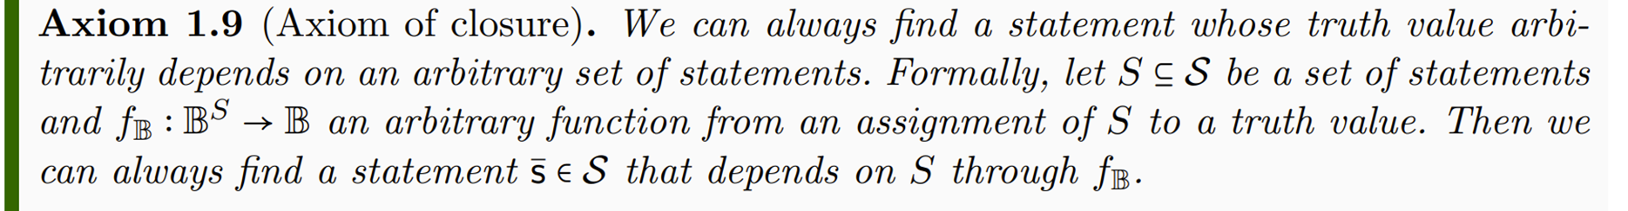

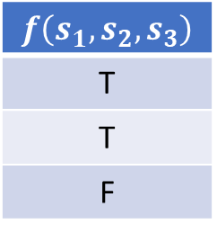
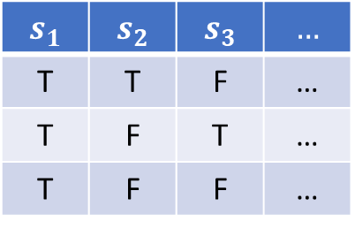
$$s_{1}$$ | $$s_{2}$$ | $$s_{3}$$ | $$…$$
T | T | F | …
T | F | T | …
T | F | F | …
$$f\left(s_{1},s_{2},s_{3}\right)$$
T
T
F
$$f_{𝔹}$$
Notes:
The logical context will allows allow all possible truth functions

Slide 15
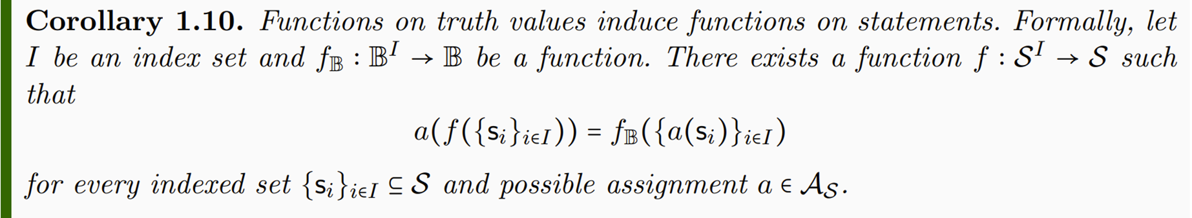

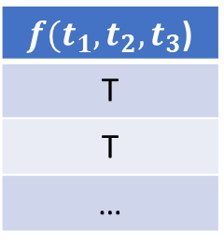
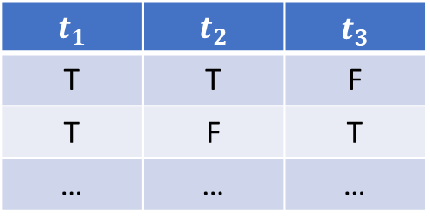
$$t_{1}$$ | $$t_{2}$$ | $$t_{3}$$
T | T | F
T | F | T
… | … | …
$f(t_{1},t_{2},t_{3}$)
T
T
…
Notes:
-> Functions on truth values induce functions on statements

Slide 16
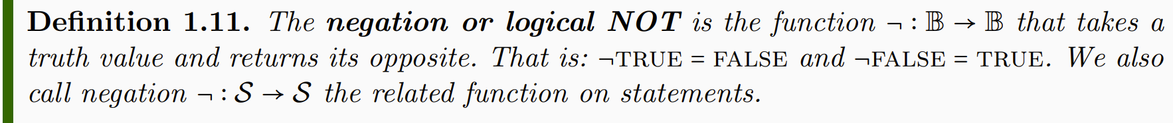
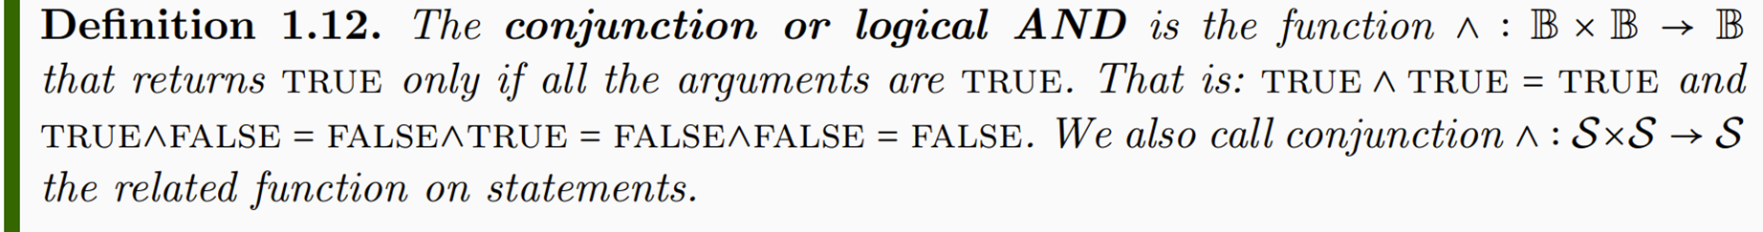
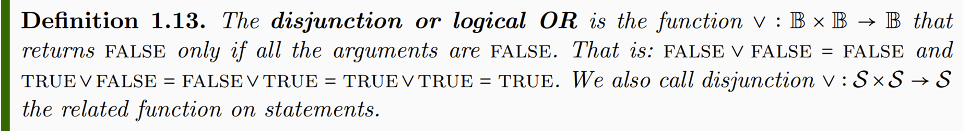

Slide 17
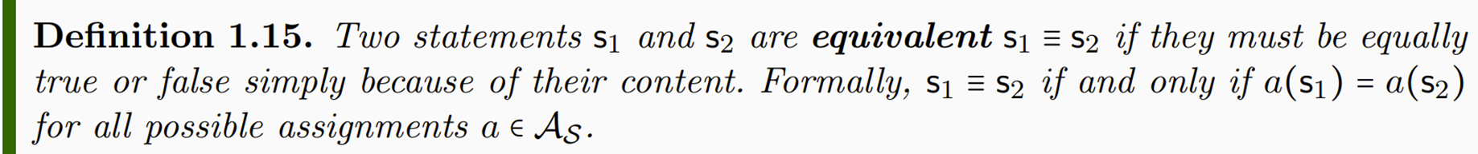
Notes:
Different notion of equivalence Table 1.2

Slide 18
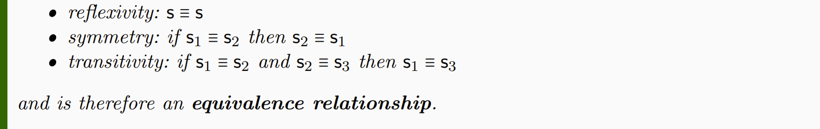
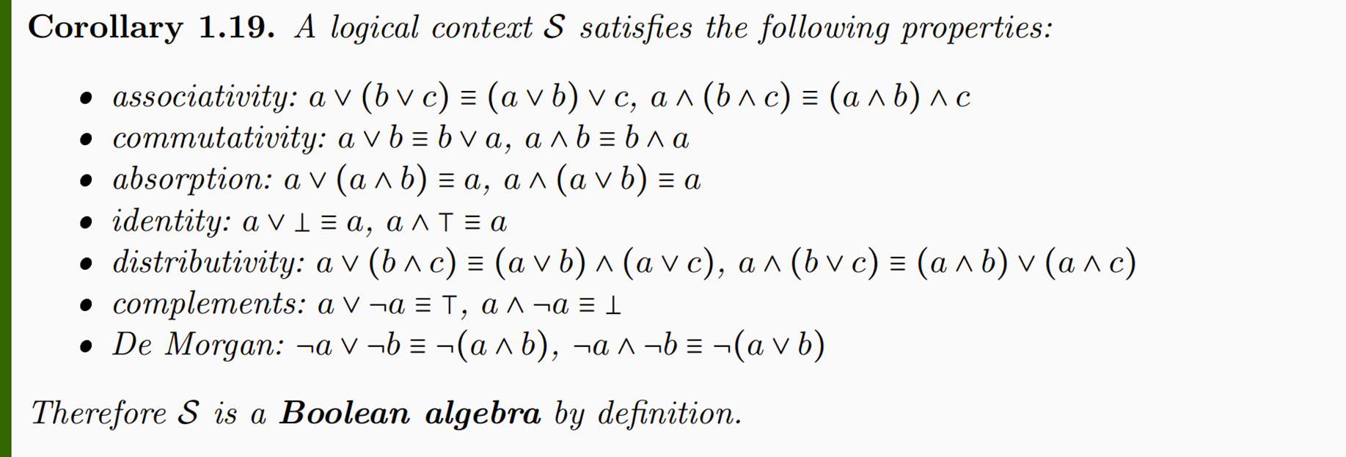

Slide 19
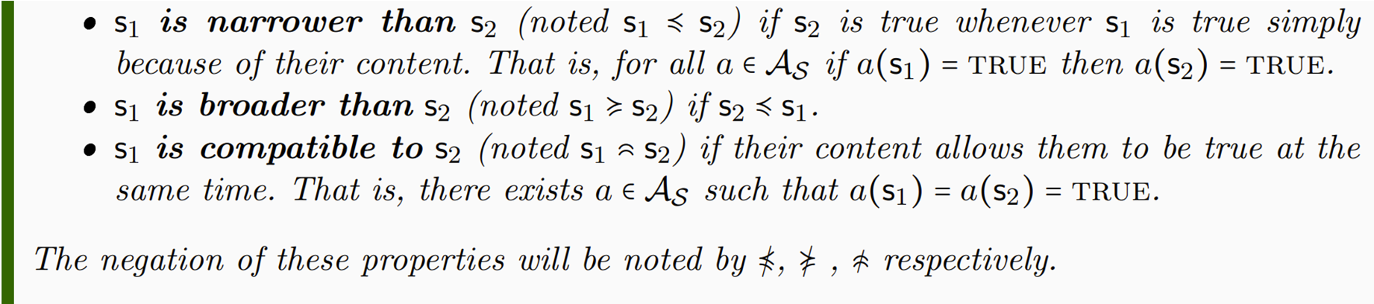
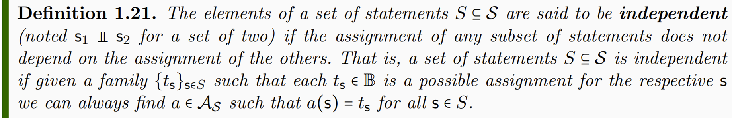

Slide 20
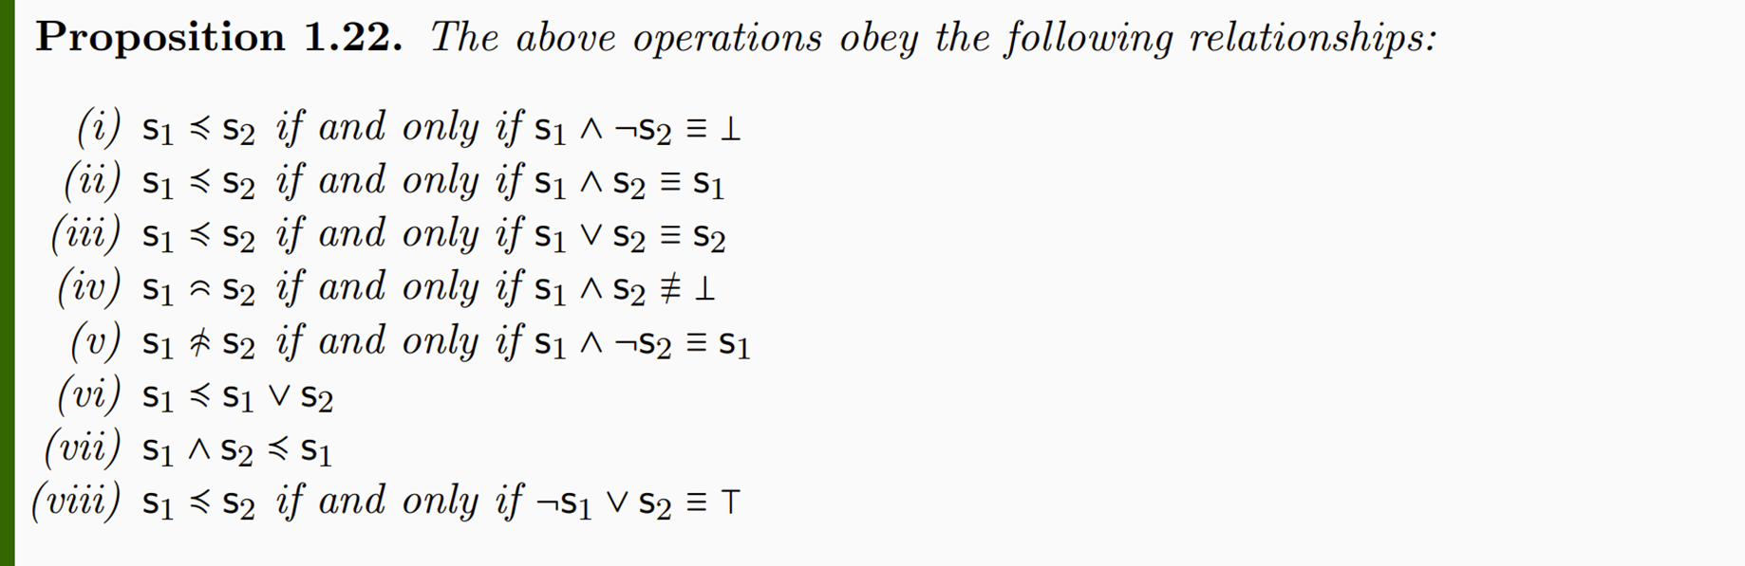

Slide 21
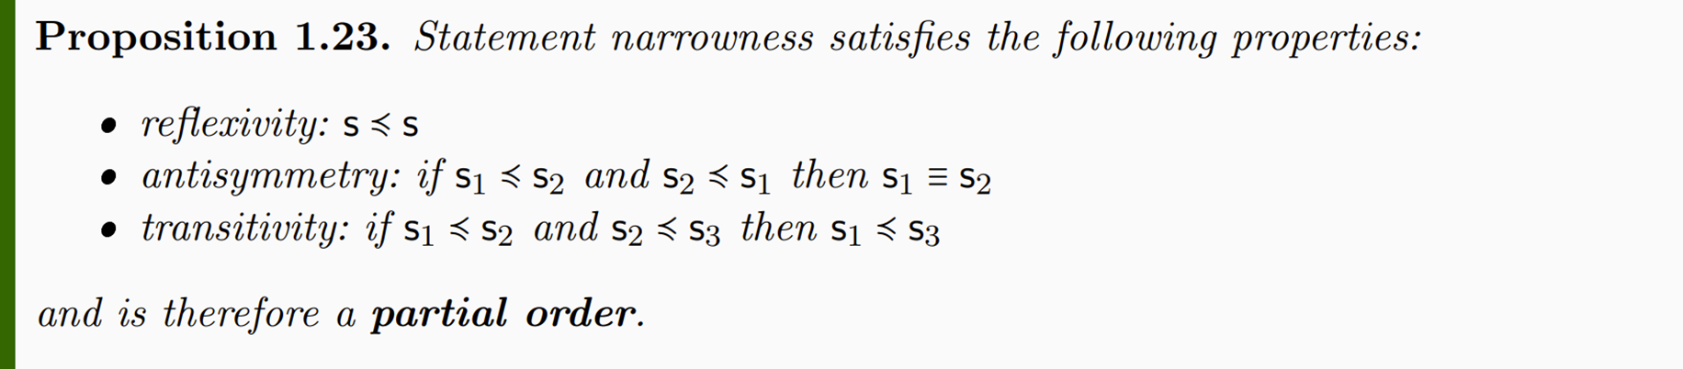
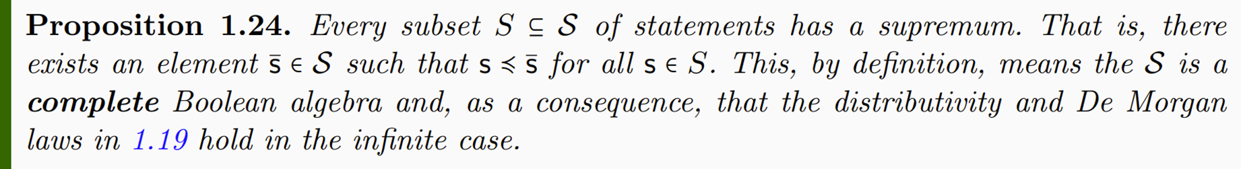
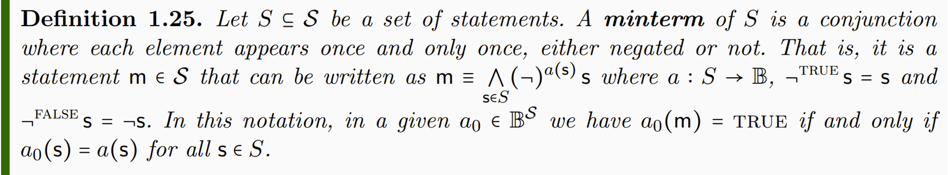

Slide 22


